Slide 1
Building Effective Metric Programs
Frank DePaola
LinkedIn: /frankdepaola
November 9, 2021

Slide 2

Agenda
Determine the WHY
Define the challenge
Discuss approaches
Identify metrics
Q&A
Notes:
Determine why building effective metric programs is a worthy investment of time and energy
Discuss some approaches to metric program structure
Discuss some
How to measure them
Who is intended audience
The stories they tell

Slide 3
“What gets measured, gets managed”
-Peter Drucker

Slide 4
Determine the WHY

Slide 5

Determine the WHY
Measure the effectiveness & quality of security program activities
Demonstrate business value when aligned with organizational goals
Prove ROI on security investments
Validate the effective management of organizational risk
Articulate focus of security investments and results
Notes:
Metrics are largely organization dependent, and their value is also generally defined by those within the organization, so in order for a security metrics program to be effective, defining the why is critical. Without that, there will be little motivation or support for the work and effort that is required to build such a program. Understanding the target audience is also equally critical, because if you are providing information that they don’t understand or value, then the metrics aren’t going to have their intended effect, which should be to demonstrate value and progress of some kind. This level of effort should culminate in a charter of some sort.
Once the charter has been defined, identifying sources of data that feed the metrics is important, along with creating simplified processes to collect this data.
Once you have the data consolidated and normalized, determining the right format to present metric data is critical. If the recipients of reported metric data don’t understand the reports, or cant track consistently over time, then the metrics wont serve their intended purpose and the effort will be largely wasted.

Slide 6
Determine the WHY
Measure security program progress & maturity over time
Highlight cost avoidance from security incidents
Keep third-parties, vendors, & suppliers honest
Identify program deficiencies
Benchmark capabilities & maturity against industry peers
Notes:
Metrics are largely organization dependent, and their value is also generally defined by those within the organization, so in order for a security metrics program to be effective, defining the why is critical. Without that, there will be little motivation or support for the work and effort that is required to build such a program. Understanding the target audience is also equally critical, because if you are providing information that they don’t understand or value, then the metrics aren’t going to have their intended effect, which should be to demonstrate value and progress of some kind. This level of effort should culminate in a charter of some sort.
Once the charter has been defined, identifying sources of data that feed the metrics is important, along with creating simplified processes to collect this data.
Once you have the data consolidated and normalized, determining the right format to present metric data is critical. If the recipients of reported metric data don’t understand the reports, or cant track consistently over time, then the metrics wont serve their intended purpose and the effort will be largely wasted.

Slide 7
Defining the Challenge

Slide 8

Defining the Challenge
Hard to justify spending resources on measuring security, versus doing security
Determining what to measure requires input from multiple parties
Establishing baselines
Reporting metrics without a supporting goal
Ensuring data completeness and accuracy
Educating the organization
Notes:
Metrics are largely organization dependent, and their value is also generally defined by those within the organization, so in order for a security metrics program to be effective, defining the why is critical. Without that, there will be little motivation or support for the work and effort that is required to build such a program. Understanding the target audience is also equally critical, because if you are providing information that they don’t understand or value, then the metrics aren’t going to have their intended effect, which should be to demonstrate value and progress of some kind. This level of effort should culminate in a charter of some sort.
Once the charter has been defined, identifying sources of data that feed the metrics is important, along with creating simplified processes to collect this data.
Once you have the data consolidated and normalized, determining the right format to present metric data is critical. If the recipients of reported metric data don’t understand the reports, or cant track consistently over time, then the metrics wont serve their intended purpose and the effort will be largely wasted.

Slide 9
Defining the Challenge
Knowing when to report on qualitative versus quantitative metrics
Identifying the target audience
Individual metrics can be composed of data from multiple sources
Determining which sources to pull data from
Average US companies use 80 different security tools
Notes:
SANS Institute found in its 2018 Security Operations Center Survey that just 54% of SOCs collected metrics, and most weren’t “business-relevant effectiveness metrics.” SANS said that without clear measurements, SOCs may run into funding resistance due to their inability to communicate to management the value of the SOC and overall security program.

Slide 10
Information Security Vendor Landscape

Slide 11
Discuss Approaches

Slide 12
Getting Started
Not a one size fits all process (business, vertical, strategy, compliance, etc.)
Establish your WHY and security metric program goals
Focus on targets for improvement
Continuously measure and report progress
Interview key stakeholders to learn what matters
After defining the WHY, determine what data to collect
Notes:
Determine your place in your metric journey. Are you starting from scratch, or revamping an existing program. Are you rethinking the metrics that matter to you, or trying to get organizational buy-in to the information you are sharing?
Build intentional processes for managing metrics as your organization's security landscape changes. Many regulatory compliance frameworks require you to perform a vulnerability scan when your network environment changes, or new systems are deployed. Similarly, you should revisit the metrics you are reporting on when systems or platforms are interchanged or new solutions are deployed.

Slide 13
Program Structure Approaches
Define which metrics you will report on
Implement SMART metrics
Group metrics based on intended audience
CISO dashboards
Executive leadership dashboards
SOC reports
Build intentional processes for managing metrics as the security landscape changes
Notes:
Determine your place in your metric journey. Are you starting from scratch, or revamping an existing program. Are you rethinking the metrics that matter to you, or trying to get organizational buy-in to the information you are sharing?
Build intentional processes for managing metrics as your organization's security landscape changes. Many regulatory compliance frameworks require you to perform a vulnerability scan when your network environment changes, or new systems are deployed. Similarly, you should revisit the metrics you are reporting on when systems or platforms are interchanged or new solutions are deployed.
Determine your place in the metric journey
Anticipate questions you may be asked

Slide 14
Metric Hierarchy
Board
►Critical incidents
►Risk posture/trend
►Spend status/ROI
►Compliance
C-Suite
►Portfolio status/health
►Financial and organizational health (e.g., budget, headcount)
Functional Leadership
►Control health (e.g., patching, malware protection)
►Mapping to controls (e.g., NIST, ISO)
►Project status/health
Operational Leads
►Operational risk (e.g., incidents, threats, vulnerabilities)
►Activities status
Notes:
Determine your place in your metric journey. Are you starting from scratch, or revamping an existing program. Are you rethinking the metrics that matter to you, or trying to get organizational buy-in to the information you are sharing?
Build intentional processes for managing metrics as your organization's security landscape changes. Many regulatory compliance frameworks require you to perform a vulnerability scan when your network environment changes, or new systems are deployed. Similarly, you should revisit the metrics you are reporting on when systems or platforms are interchanged or new solutions are deployed.

Slide 15

Metric Program Checklist
Define goals & objectives
Identify relevant metrics
Develop strategies for generating metrics
Establish benchmarks & targets
Develop metrics reporting system
Develop & implement action plan
Establish formal program lifecycle review process
Notes:
Determine your place in your metric journey. Are you starting from scratch, or revamping an existing program. Are you rethinking the metrics that matter to you, or trying to get organizational buy-in to the information you are sharing?
Build intentional processes for managing metrics as your organization's security landscape changes. Many regulatory compliance frameworks require you to perform a vulnerability scan when your network environment changes, or new systems are deployed. Similarly, you should revisit the metrics you are reporting on when systems or platforms are interchanged or new solutions are deployed.

Slide 16
Ask Questions
What’s important?
Compliance
Risk management
Business enablement
What’s broken?
Process
Technology
What’s basic?
What’s new?
Notes:
Determine your place in your metric journey. Are you starting from scratch, or revamping an existing program. Are you rethinking the metrics that matter to you, or trying to get organizational buy-in to the information you are sharing?
Build intentional processes for managing metrics as your organization's security landscape changes. Many regulatory compliance frameworks require you to perform a vulnerability scan when your network environment changes, or new systems are deployed. Similarly, you should revisit the metrics you are reporting on when systems or platforms are interchanged or new solutions are deployed.

Slide 17
Answer Questions
How will information be reported to stakeholders?
If an issue is determined via the metrics program, what is each stakeholder’s responsibility regarding remediation efforts?
Will there be service-level agreements (SLAs) for solving and correcting concerns within the metrics?
Where can security capabilities positively influence business objectives?
Are we aligning information security program objectives to business needs?
Are we investing in the right areas & tools?
Are we making a difference?
Notes:
Determine your place in your metric journey. Are you starting from scratch, or revamping an existing program. Are you rethinking the metrics that matter to you, or trying to get organizational buy-in to the information you are sharing?
Build intentional processes for managing metrics as your organization's security landscape changes. Many regulatory compliance frameworks require you to perform a vulnerability scan when your network environment changes, or new systems are deployed. Similarly, you should revisit the metrics you are reporting on when systems or platforms are interchanged or new solutions are deployed.
Demonstrate effective management of prioritized risks
Provide a picture of how business critical assets are impacted
Provide accountability for decisions and help to justify security spend

Slide 18
Metric Operating Model
Network Compromise | Data Exposure/Loss
Software Vulnerability | Users & Devices
Regulatory Risk | System Compromise / Failure
Threat Categories
Customer Data Theft
Code Theft
Threats
Risk Magnitude
Data Classification Standard
Media Destruction Standard
Incident Response Plan
Controls
Control Effectiveness
Public disclosure of security breach and fees | % of data elements classified according to standard
KPI Status
KPI’s
Operational Metrics
Operational Metrics
% systems without updated AV
# confirmed credential compromises
Notes:
Determine your place in your metric journey. Are you starting from scratch, or revamping an existing program. Are you rethinking the metrics that matter to you, or trying to get organizational buy-in to the information you are sharing?
Build intentional processes for managing metrics as your organization's security landscape changes. Many regulatory compliance frameworks require you to perform a vulnerability scan when your network environment changes, or new systems are deployed. Similarly, you should revisit the metrics you are reporting on when systems or platforms are interchanged or new solutions are deployed.
6 threat categories
300 Threats
177 Controls
25 KPI’s
Operational Metrics change over time

Slide 19
Cybersecurity Reporting Maturity Model
Initial | Repeatable | Defined | Managed | Optimized
►Ad hoc metrics; created only when requested. | ►Tactical metrics focused on select security domains. | ►Metrics cover most security domains. | ►Strategic and tactical metrics, KPIs* and KRIs* to monitor coverage and effectiveness. | ►Dashboards are actively used in decision making.
►Manual dashboards (e.g., Excel, PowerPoint). | ►Manual dashboards created at some regular frequency. | ►Metrics provide high-level view of security risk across the enterprise. | ►Dashboards leveraged for decision-making. | ►Real-time dashboard with advanced analytics capabilities driven by threat intelligence and predictive modeling.
►Highly manual effort. | ►Effort still largely manual. | ►Dashboard development is operationalized in a visualization tool with many manual repeatable steps. | ►Mostly automated dashboard; very limited manual effort. | ►Granular views and broader audience (e.g., business units, Human Resources, Privacy, regional views, financial views).
 | ►Metrics may be influenced by industry frameworks. | ►Data is pulled from the source system for majority of metrics (e.g., Splunk, Qualys). | ►Most metrics pulled from source system in near real-time. | ►Dashboard utilized for communications and awareness across enterprise.
 |  | ►Metrics are aligned to leading industry frameworks (e.g., NIST*, ISO*). | ►Metrics measure health against industry frameworks.
 |  |  | ►Dashboard audience expands to key executives (e.g., Board, Audit Committee).

Slide 20
Identifying Metrics

Slide 21
Identifying Important Metrics
Security Operations Metrics
# of unmanaged devices on the network/month
% of legacy clients on the network/month
Avg time spent per alert by criticality
Mean time to recovery (MTTR)
Mean time to detection (MTTD)
% of incidents handled at Tier 1, 2, 3
Notes:
Metrics are largely organization dependent, and their value is also generally defined by those within the organization, so in order for a security metrics program to be effective, defining the why is critical. Without that, there will be little motivation or support for the work and effort that is required to build such a program. Understanding the target audience is also equally critical, because if you are providing information that they don’t understand or value, then the metrics aren’t going to have their intended effect, which should be to demonstrate value and progress of some kind. This level of effort should culminate in a charter of some sort.
Once the charter has been defined, identifying sources of data that feed the metrics is important, along with creating simplified processes to collect this data.
Once you have the data consolidated and normalized, determining the right format to present metric data is critical. If the recipients of reported metric data don’t understand the reports, or cant track consistently over time, then the metrics wont serve their intended purpose and the effort will be largely wasted.

Slide 22
Identifying Important Metrics
Security Operations Metrics
Avg incident handling time per analyst
% of incidents where you can make threat attribution
# of false positives per period or per security platform
Average vulnerability age
# misconfigured cloud assets
Notes:
https://www.logicmanager.com/erm-software/2018/09/05/how-to-measure-your-enterprise-risk-management-effectiveness/

Slide 23
Identifying Important Metrics
Enterprise Risk Metrics
The number of systemic risks identified
The percentage of key risks monitored
The percentage of key risks mitigated
Executive Level Reporting Metrics / CISO Dashboards
Focus on program level indicators
Refrain from reporting tactical metrics
Notes:
https://www.logicmanager.com/erm-software/2018/09/05/how-to-measure-your-enterprise-risk-management-effectiveness/

Slide 24
Identifying Less-Useful Metrics
Overall volume of data the business generates
Detected intrusion attempts
Number of successful system logins
# of security tickets closed
# of dormant AD accounts
Notes:
Focusing on the wrong metrics can actually incentivize the team to perform work that doesn’t really matter to the organization

Slide 25
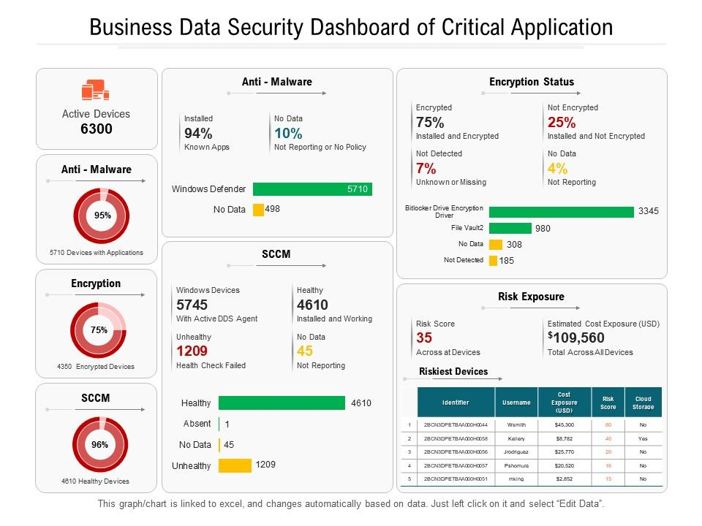
Gathering & Presenting Metrics
Manual method & assessments
Scheduled reports
GRC tools
IRM dashboards
BI platforms
Notes:
https://www.logicmanager.com/erm-software/2018/09/05/how-to-measure-your-enterprise-risk-management-effectiveness/

Slide 26

Key Takeaways
Define the WHY & your target audience
Clearly define your goals!!!
Both organizational and metric aligned goals
Get started immediately! Grow as you go!
Agree on frequency and reporting structure
Create continuous improvement process around your metric program
Determine how to automate, simplify and consistently deliver metrics
Notes:
Metrics are largely organization dependent, and their value is also generally defined by those within the organization, so in order for a security metrics program to be effective, defining the why is critical. Without that, there will be little motivation or support for the work and effort that is required to build such a program. Understanding the target audience is also equally critical, because if you are providing information that they don’t understand or value, then the metrics aren’t going to have their intended effect, which should be to demonstrate value and progress of some kind. This level of effort should culminate in a charter of some sort.
Once the charter has been defined, identifying sources of data that feed the metrics is important, along with creating simplified processes to collect this data.
Once you have the data consolidated and normalized, determining the right format to present metric data is critical. If the recipients of reported metric data don’t understand the reports, or cant track consistently over time, then the metrics wont serve their intended purpose and the effort will be largely wasted.
Continuous, time bound
Reporting format & recipients
Start reporting data right away!

Slide 27
Thank You
Frank DePaola
Resources: https://github.com/Figgs1/evantaciso_2021
LinkedIn: /frankdepaola
Twitter: @fdepaola

